Slide 1

XYZ Driver Association Case Study
100
Enterprise Systems Development

Slide 2
Group members
Fintan Kennedy – 14022421
Neptali Ortega-Gutierrez
Darren Stamper -
Lam Ninh – 17045580
Thao Ly - 18042472

Slide 3
Sprint 2 deliverables
Task delivery form
Updated project plan
Completion of backend architecture
Partial completion of system functionality

Slide 4
Roles – member, admin, system
Member | Completed | Admin | Completed
Make claim | ✓ | Add membership | ✓
Pay fees | ✓ | View membership requests | ✓
Log in | ✓ | Suspend members | ✓
Register (extension of log in) | ✓ | View outstanding balances | ✓
View balance | ✓ | Charge members | ✓
 |  | Claim eligibility assessment | ✓

Slide 5
Tasks identified after Sprint 1
Create users table
Create payments table
Create members table
Create claims table
Create database access for all tables
Finish user login page jsp file
Add user registration
Create dashboard pages for users and admin
Create view for admin to see daily activities and reports

Slide 6
Gantt charts

Slide 7
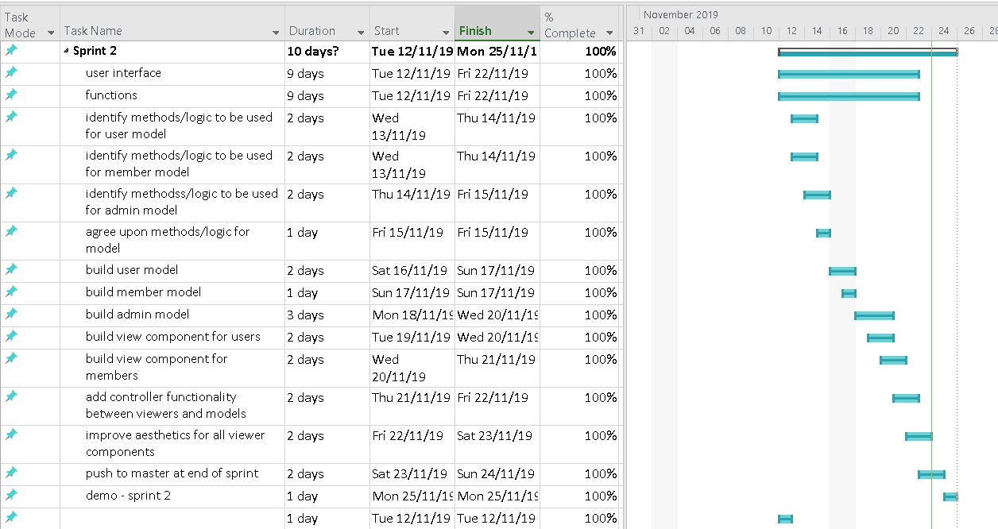
Updated Sprint 2

Slide 8
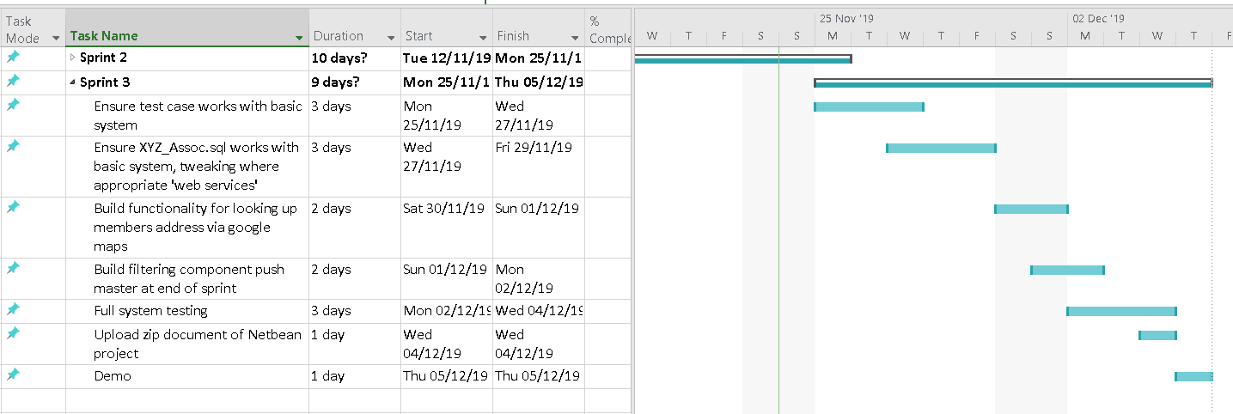
Updated Sprint 3

Slide 9
Task Delivery Form
Update roles and tasks
Update Gannt Chart
Reanalyze the system
Make sure the database is connected
Create user dashboard
Create admin dashboard
Add user registration
Create admin users, payments, members, claims tables
Test all functions
Making the presentation slides
 | Tasks
Group Members | T₁ | T₂ | T₃ | T₄ | T₅ | T₆ | T₇ | T₈ | T₉ | T₁₀ | Signature
Fintan Kennedy | ✓ | ✓ | ✓ |  |  |  |  |  | ✓ | ✓
Neptali Ortega-Gutierrez | ✓ |  | ✓ |  |  | ✓ |  | ✓ | ✓
Darren Stamper | ✓ |  | ✓ |  | ✓ |  | ✓ |  | ✓
Lam Ninh | ✓ |  | ✓ | ✓ |  | ✓ |  | ✓ | ✓
Thao Ly | ✓ |  | ✓ |  | ✓ |  |  | ✓ | ✓
Status of Completion (%) | 100 | 100 | 100 | 100 | 100 | 100 | 100 | 100 | 100 | 100

